Slide 1



Azure IoT Central architecture
UI Shell
Cloud gateway
Reporting
Rules & actions
Metadata management
RBAC
Core services
Pervasive features
Azure infrastructure
IoT field devices
Time series store
Application data store
Security
Continuous data export
Blob storage
Event Hubs
Service Bus

Slide 2







PREFERRED SOLUTION
DATA INGEST / DEVICE MANAGEMENT / REPORTING
EVENT PROCESSING
REAL-TIME SCORING
IOT CENTRAL
AKS
(Scoring Web Service)
AZURE FUNCTION
Continuous Export
COLD STORAGE
EVENT INGEST
DEPLOY MODEL
IoT Field Devices
AZURE STORAGE
EVENT HUBS
PUMP STATUS ALERTS
ADVANCED ANALYTICS & MODEL TRAINING
MICROSOFT FLOW
AZURE DATABRICKS

Slide 3




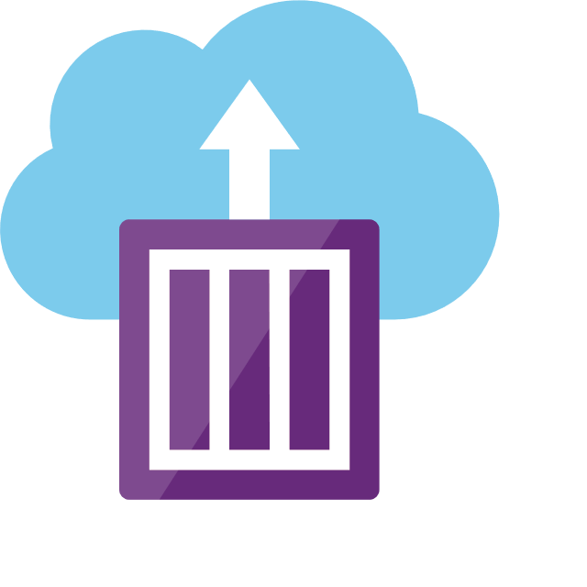
Infographic for common scenarios
Ingest
Process & store
Prep & train
Model &
serve
Predict
Real-time Data
Machine learning services and libraries (Python, Scala, Java, R, Spark, Hadoop, SQL ML Services)
Event Hubs / Service Bus
Predictive maintenance model served by ML service hosted in container, web service, or database service
Azure IoT Hub
Database & Web App
Sensors & IoT
devices
Azure Functions / Web App API
Process
Azure IoT Central
Azure IoT Central
AKS / ACI
Score
Notes:
SQL Server 2019 Integrated AI and Machine Learning

